Slide 1
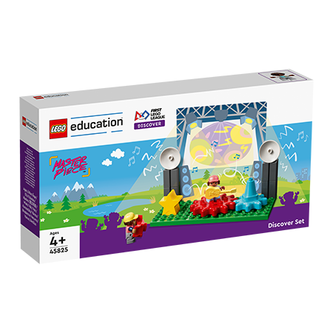
GİRİŞ
HAYDİ
BAŞLAYALIM !
Notes:
Discover and Explore!
Welcome to MASTERPIECE! The children will explore how people share what they love to do with others. They will learn about the different places where ideas are shared, who they are shared with, and the people behind the scenes that make experiences happen.
Build and Create!
The children will build a stage that can be used to host a music concert or theatrical performance, or to display an object in a museum. They will use elements from the STEAM Park set to build their ideas. They will create their own place to share their interests and will consider the audience. They will test and improve their designs and creations.
Share!
The children will record their ideas and designs in their Engineering Notebooks. They will share their builds and what they learned with others. Finally, they will participate in the celebration event, to which you can invite their families and friends. Most importantly they will have fun!

Slide 2
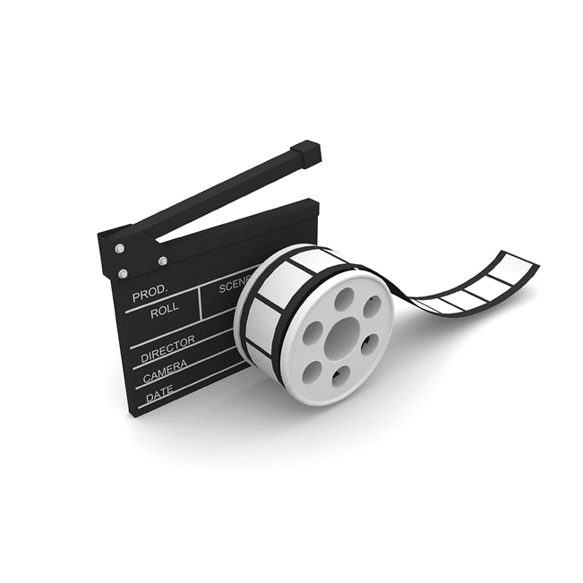
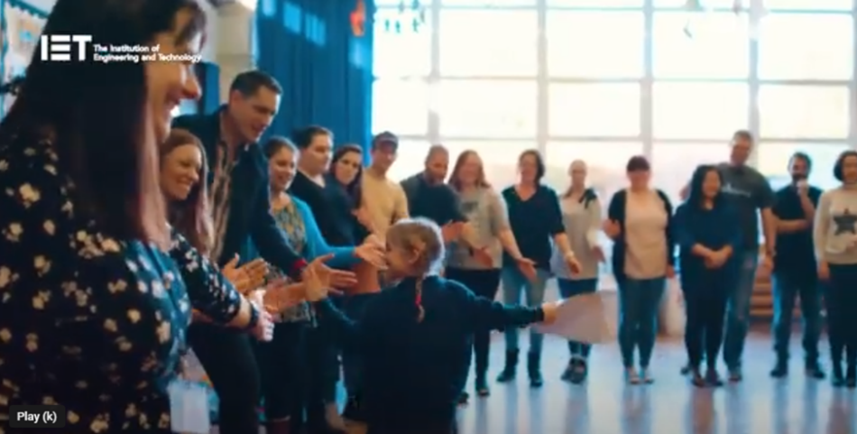
Minik Bilim Kahramanları Keşfediyor /
FIRST® LEGO® League Discover Nedir?
Video dili İngilizce’dir.
Notes:
Watch video - What is FIRST LEGO League Discover? – 2:51 mins – https://www.youtube.com/watch?v=Y_8xKTQFFHY
FIRST LEGO League Discover is a global STEM program for children and young people aged 4-6.
The IET are proud to be the delivery partners for FIRST LEGO League in the UK and Ireland, because FIRST LEGO League is the perfect program to start young people thinking about engineering as a potential career path.

Slide 3
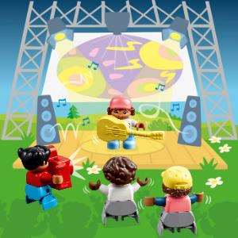
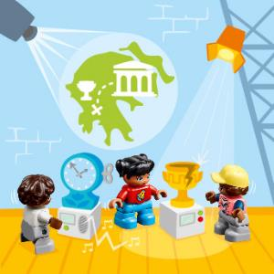
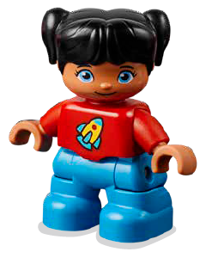
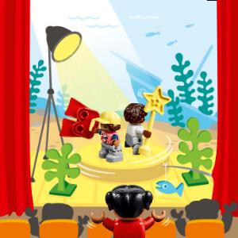
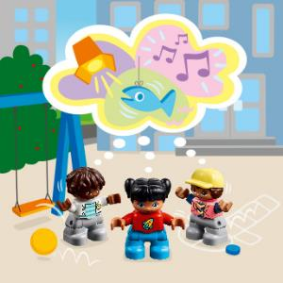
KEŞİF HİKAYESİ
Izzy, müzik gösterilerindeki seslere ve ışıklara bayılıyor.
Izzy, müzede sanat ve tarih hakkında bilgi edinmenin eğlenceli olduğunu düşünüyor.
Bir tiyatroda sahnenin hareket etmesi ve dönmesi Izzy'yi hayrete düşürüyor.
Izzy ve arkadaşlarının kendi gösterileri için çok parlak fikirleri var!
Notes:
Discover Story - (TMG page 5)

Slide 4
Her Oturum Aşağıdakileri İçerir
Büyük Soru
Altı Tuğla İle Isınma
Keşif Görevi
İnşa Görevi
Paylaşma Görevi- sınıf arkadaşlarınızla veya Mühendislik Defterinizle
Temizlik
Notes:
Big question: Each session has a Big Question that can be shared to frame the session.​
Six Bricks Warm-Up: Every session has a short warm-up activity using the six bricks sets.
Explore Task: The sessions start with a task to help students learn about the topic.
Create Task: Students will create builds during each session.
Share Task with your classmates or in your Engineering Notebook: Students share their work by either showing and explaining their builds or completing a task in their Engineering Notebook.
Clean Up: Take time during each session to have the students clean up and put away the materials.

Slide 5
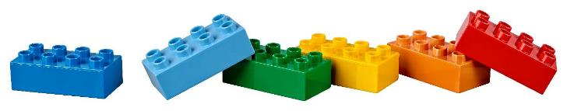
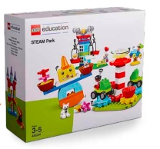
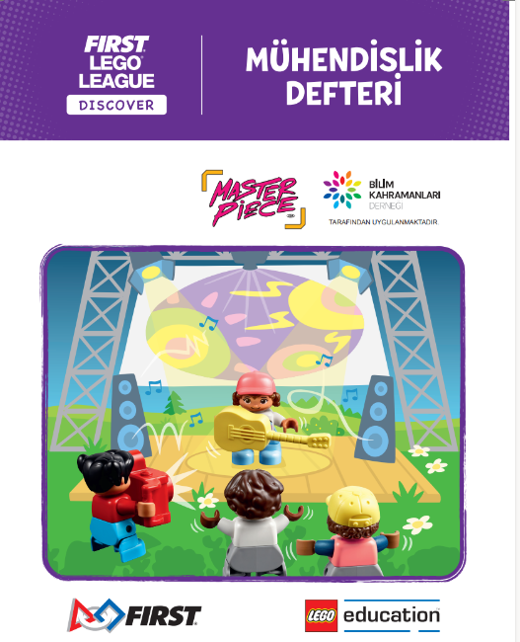
Kullanacaklarınız:
Altı Tuğla
Keşif Seti
Mühendislik Defteri
Keşif Matı
STEAM Park Seti
Notes:
Discover Set with Mat and Six Bricks
The Discover set consists of the Discover model, LEGO® DUPLO® figures, Six Bricks sets, mat, and building cards. The Discover model is intended to help children connect to the theme and provide a starting point for discussions and further building. The mat is used as a collaboration space to bring the models together. Each Discover set includes five sets of Six Bricks for use in the classroom. There are enough sets to give one to each child, plus one for the teacher. Each child will need one of each of the six colored bricks. The Six Bricks in this set are in addition to the Six Bricks in the Discover More set that goes home.
Engineering Notebook
You will receive a set of Engineering Notebooks, which provide a place for children to record ideas and drawings. There is one page to fill in for every other session. Provide one notebook to each child.
LEGO® Education STEAM Park Set
All teams will use the STEAM Park set to explore STEM concepts and form the basis of their team model. This set will be used throughout sessions, as well as at the celebration.
There is also a STEAM Park Teacher Guide that contains lesson plans as well as other ideas and inspiration.
STEAM Park Teacher Guide PDFs – https://education.lego.com/en-us/product-resources/steam-park/teacher-resources/teacher-guide-pdfs
We suggest pre-teaching the following sessions from the teacher guide if the class or students are new to STEAM Park:
1. Functional Elements
2. Welcome to STEAM Park
3. Gears

Slide 6

MASTERPIECESM
MASTERPIECESM Sezon tanıtım videosunu izlemek için FIRST® LEGO® League
YouTube Channel kanalını ziyaret edin.
Video dili İngilizce’dir.
Notes:
Watch the MASTERPIECESM Season Launch Video - https://www.youtube.com/c/FIRSTLEGOLeagueofficial

Slide 7



LEGO, LEGO logosu, DUPLO ve DUPLO logosu, LEGO Group’un tescilli ticari markalarıdır. ©2023 LEGO Group.
Tüm hakları saklıdır.
FIRST®, FIRST® logosu ve FIRST® IN SHOWSM For Inspiration and Recognition of Science and Technology (FIRST)’nin tescilli
ticari markasıdır. LEGO®, LEGO Group’un tescilli ticari markasıdır. FIRST® LEGO® League ve MASTERPIECESM, FIRST ve
LEGO Group’un ortak ticari markalarıdır.
©2023 FIRST ve LEGO Group. Tüm hakları saklıdır.

Slide 8
Diğer oturumların slaytlarına ulaşmak için
kayıtlı takımların koç ya da danışmanları
minikbkb@bilimkahramanlari.org adresine yazabilir.

